Slide 1




Sri Lanka Institute of Information Technology
GUNAWARDANA K.P IT20298876
Data Science | 2024

Slide 2
Sri Lanka Institute of Information Technology
HATE SPEECH DETECTION
IT4010
Research project
Data Science | 2024

Slide 3
Abstract
This project focuses on detecting hate speech in system documents by evaluating 36 models, including classical machine learning and deep learning approaches. Classical models employed Bag of Words and TF-IDF, while deep learning models utilized Keras embedding, Word2Vec, and a customized Word2Vec model. After evaluating each model’s accuracy and F1 score, the best-performing model was selected for hate speech detection. This approach ensures a robust solution for identifying harmful content in diverse textual data
Gunawardna K.P IT20298876
Data SCience | 2024

Slide 4
Overview
Introduction
Problem
Gap Analysis
Objectives
Proof Of Concept
Completeness of the Work
Gunawardana K.P IT2029887
Data Science | 2024

Slide 5
Introduction
Hate speech, rooted in bias and animosity toward race, ethnicity, religion, nationality, sexual orientation, gender identity, or similar characteristics, can inflict serious damage by causing emotional distress and alienation in affected communities. Its prevalence is growing across social media, news outlets, and political discourse, where it is often employed to sway public opinion and promote divisive narratives.
Gunawardna K.P IT20298876
Data SCience | 2024

Slide 6
Explicit Hate Speech
Implicit Hate Speech
Definition: Direct and overt expressions of hate, often involving cursing, slurs, or highly offensive language
Definition: Subtle or coded hate speech that conveys discriminatory or offensive messages without using overtly hateful language. It can involve sarcasm, dog whistles, or context-dependent offensive statements.
.
Example
"You're such a useless piece of shit, nobody will ever care about you.“
"I don't give a damn what you think, you're just a dumb bitch."
Example
"People like you should be wiped off the planet."
"Women are only good for cooking and cleaning, nothing more."
Explicit Hate Speech
Jayathilaka H.A.D.A.P.M IT21032738
Cyber Security | 2024

Slide 7
Hate speech in secure documentation
Military Intelligence Communication - secure communication between military officials during an international conflict. These communications could include briefings, reports, or real-time messages. It may contain offensive, derogatory, or harmful language targeted at specific groups, nationalities, or individuals within these documents. (share classified intelligence report)
Diplomatic Cable Communications in International Relations - In the realm of diplomacy, secure communication channels are used for the exchange of sensitive information between governments or diplomatic missions. (A diplomatic cable is being securely transferred between two embassies, containing updates on a conflict or trade negotiations between their respective nations)
Script and Content Review in the Entertainment Industry - In the entertainment industry, especially in film, television, and online content creation, hate speech detection can be vital during the review and approval processes of scripts, screenplays, or any public statements made by celebrities.
Gunawardna K.P IT20298876
Data Science| 2024

Slide 8

Advantage
Detecting and filtering out hate speech helps in maintaining a safe and respectful environment within secure documents and communications
can prevent the spread of false or misleading information that could exacerbate tensions or conflict.
elps ensure compliance with legal and regulatory requirements related to hate speech, reducing the risk of legal consequences.
Jayathilaka H.A.D.A.P.M IT21032738
Cyber Security | 2024

Slide 9

Research Problem
Problem 1
How can we boost the accuracy and F1 score of hate speech detection models to ensure more reliable and effective identification of harmful content?
Problem 2
How can we address the challenge of imbalanced datasets to improve the fairness and reliability of hate speech detection models?
Gunawardana K. P IT20298876
Data Science | 2024

Slide 10

Gap Analysis
Future research directions for enhancing hate speech detection may focus on improving model performance by increasing the F-score value. This can be achieved by refining algorithms to better balance precision and recall, exploring advanced techniques such as deep learning and transfer learning, and incorporating more diverse and comprehensive training datasets. By addressing these areas, researchers aim to develop more accurate and robust models capable of effectively identifying and mitigating hate speech in various contexts.
Gunawardana K.P IT2o298876
Data Science | 2024

Slide 11
Objectives
Data Preprocessing Tokenization, Normalization, Stopword removal, Stemming
Handling imbalanced data set – Oversampling, Undersampling
Data representation – Bag of words, Word embeddings, Term Frequency – Inverse Document Frequency
Implementation ML Models
Evaluation – Metrics, confusion metrics
Erorr Analysis
.
Gunawardana K.P IT20298876
Data Science | 2024

Slide 12

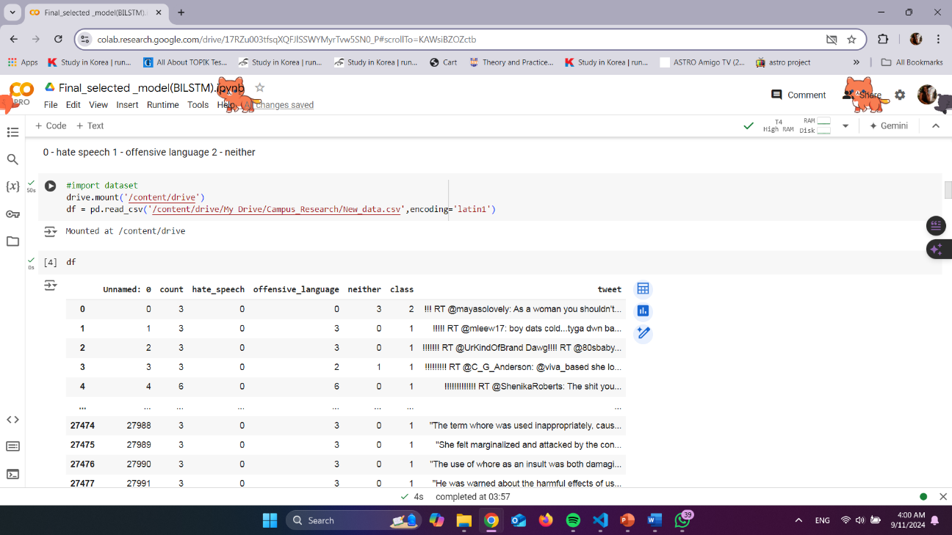
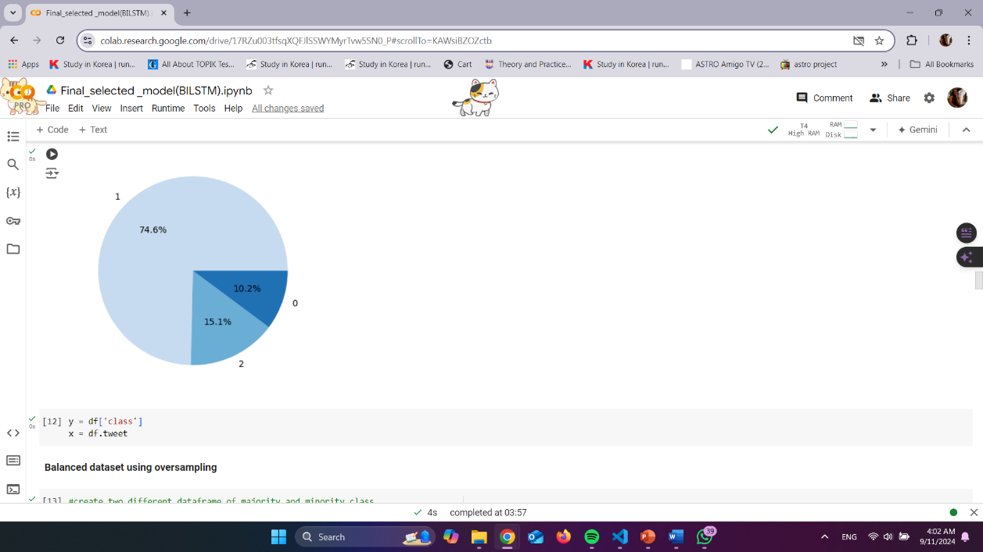
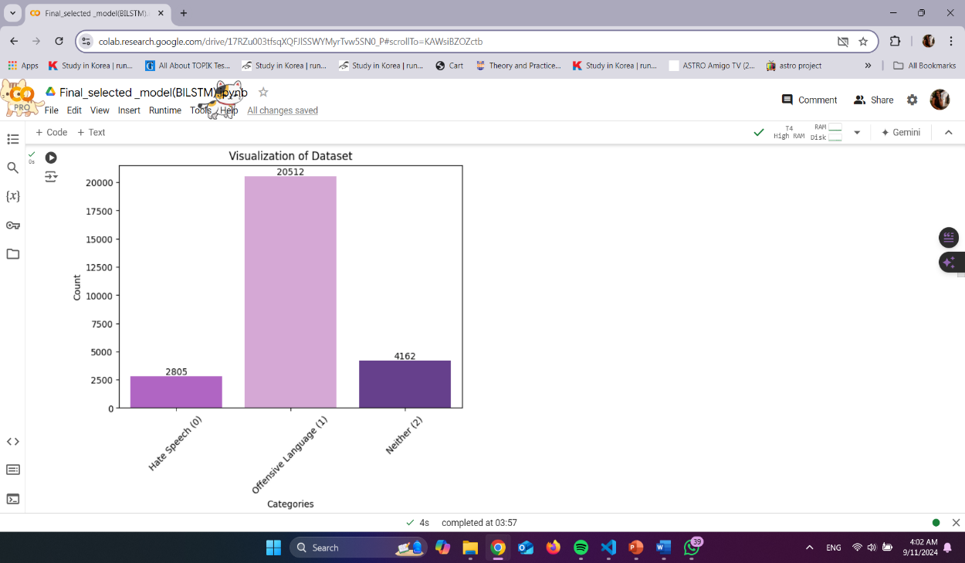
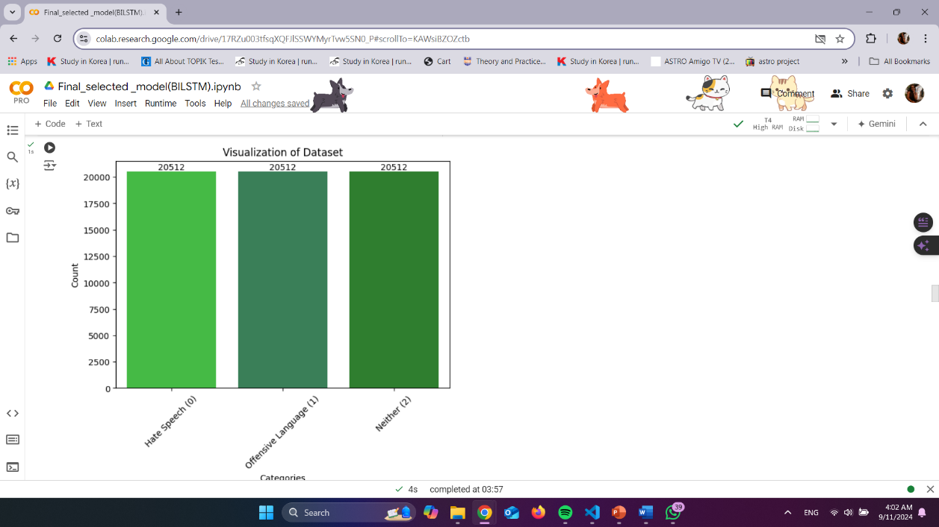
DATASET
Proof Of Concept
Oversampling and Undersampling are used for the balanced data set
Overview

Slide 13
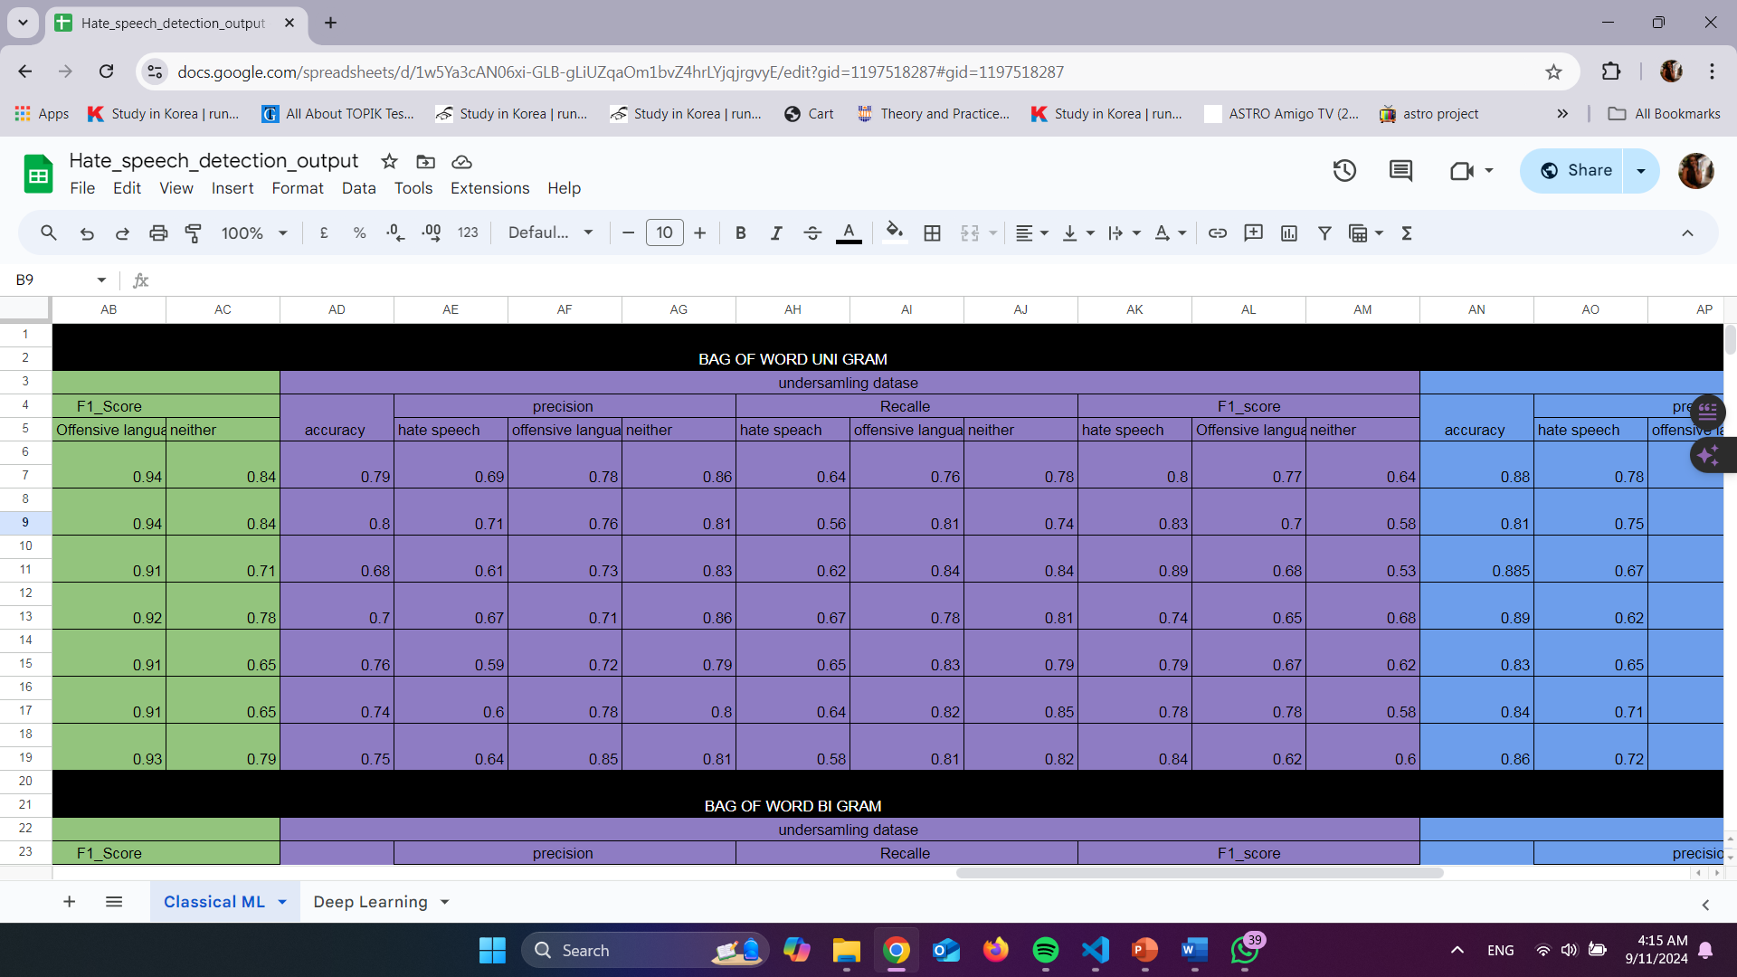
Trained Classical machine learning
models
Proof Of Concept
Classical ML model - Support Vector Machines (SVM), Logistic Regression, Decision Trees, Naive Bayes, K-Nearest Neighbors (KNN), Random Forest, and Passive Aggressive
Word representation – Bag of Words (BoW) and Term Frequency-Inverse Document Frequency (TF-IDF).
https://docs.google.com/spreadsheets/d/1w5Ya3cAN06xi-GLB-gLiUZqaOm1bvZ4hrLYjqjrgvyE/edit?usp=sharing
Overview

Slide 14
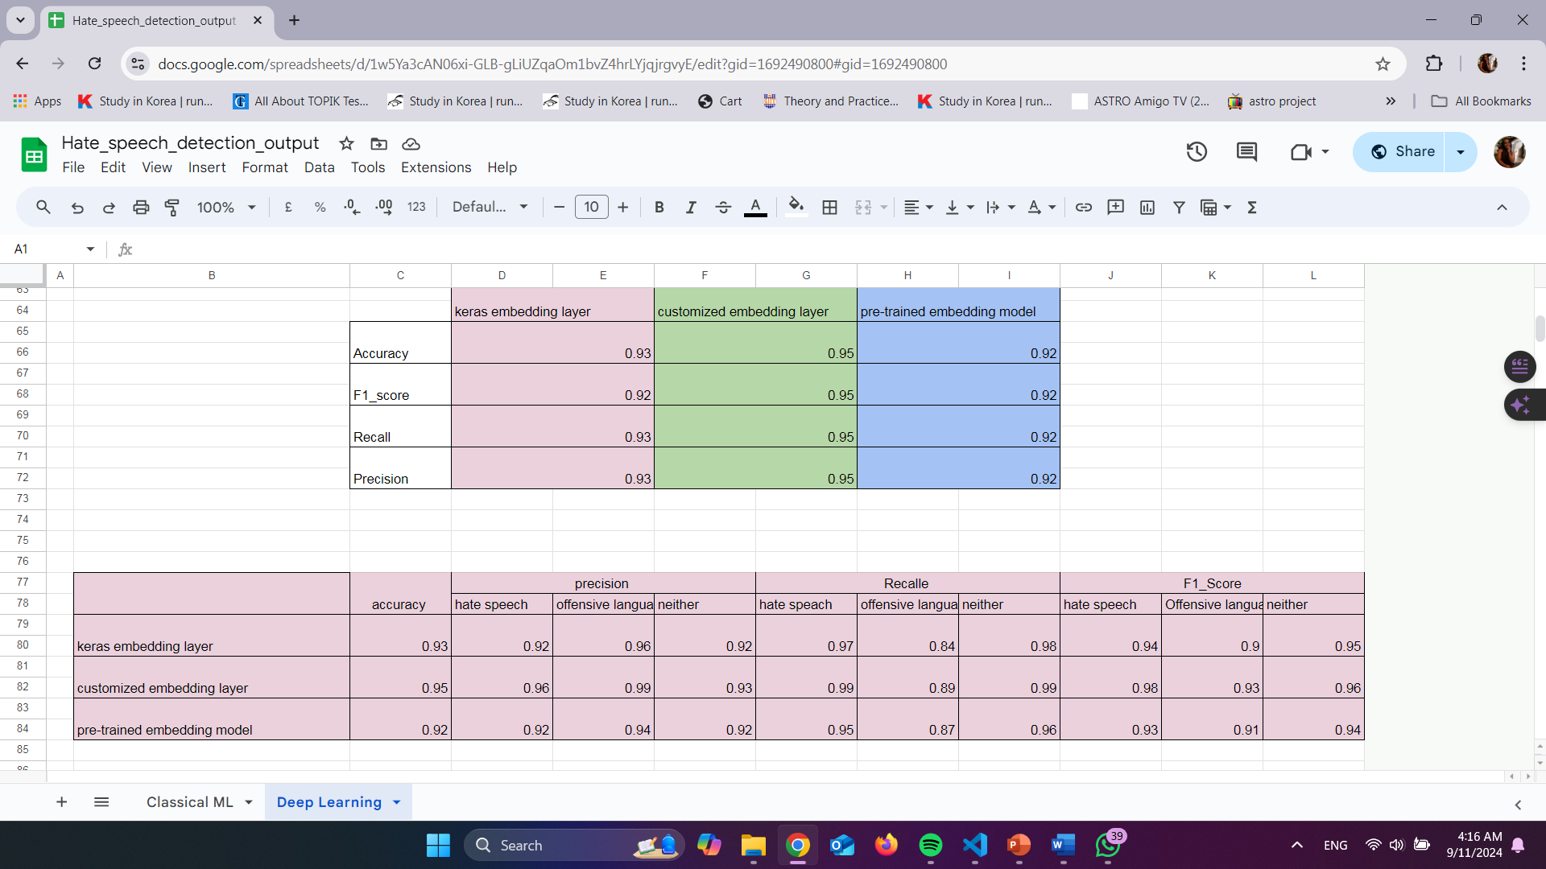
Deep Learning learning
models
Proof Of Concept
Deep learning models: RNN, CNN, LSTM, BiLSTM
Word representation: pretrained Word2Vec model, customized Word2Vec model, and Keras embedding model
https://docs.google.com/spreadsheets/d/1w5Ya3cAN06xi-GLB-gLiUZqaOm1bvZ4hrLYjqjrgvyE/edit?usp=sharing
Overview

Slide 15
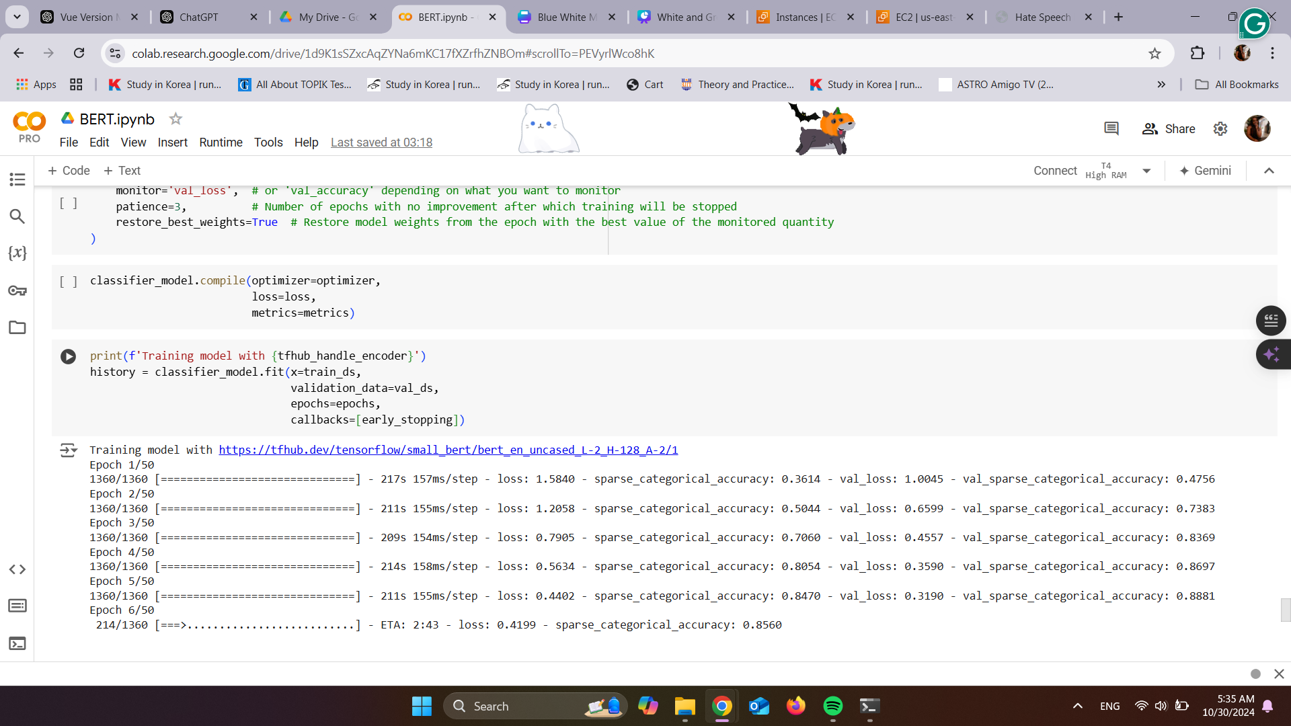
Transformers (BERT)
Proof Of Concept
Overview

Slide 16
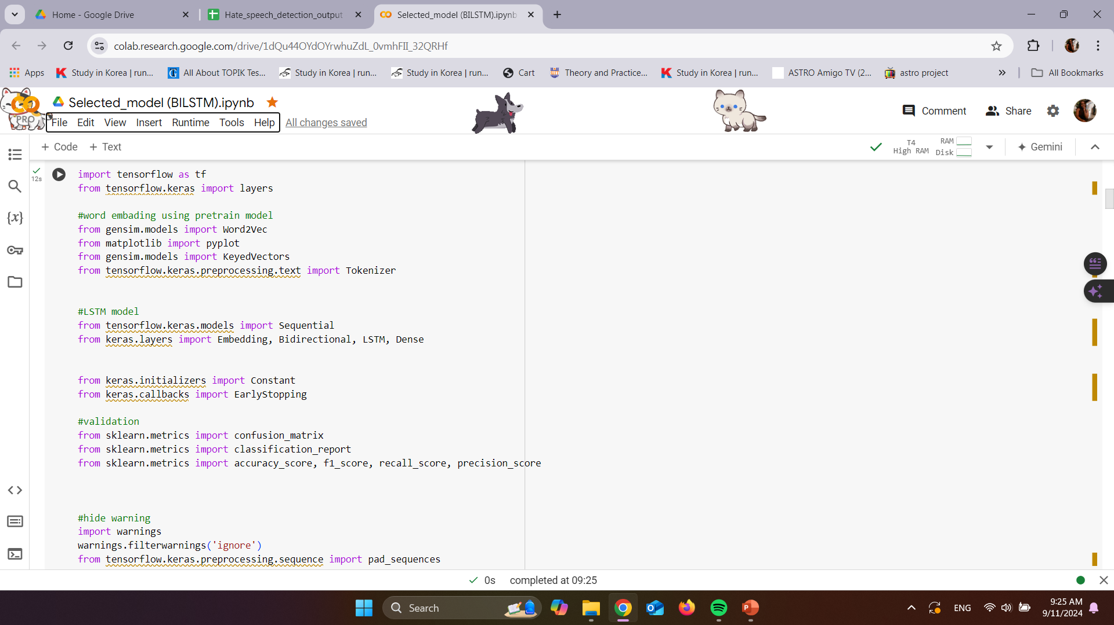
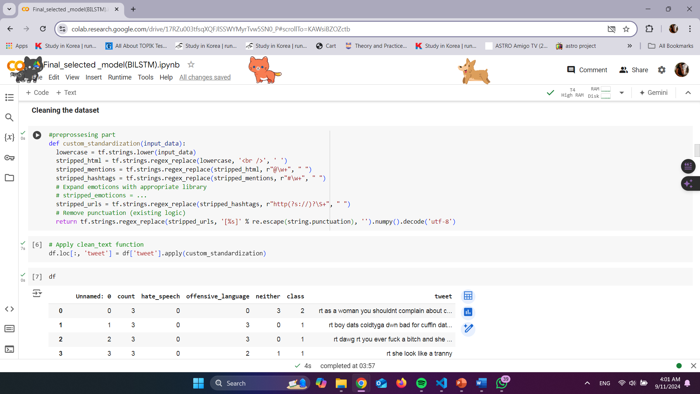
LIBRARIES AND PREPROSSING
Proof Of Concept
(According to the selected model )
Overview

Slide 17
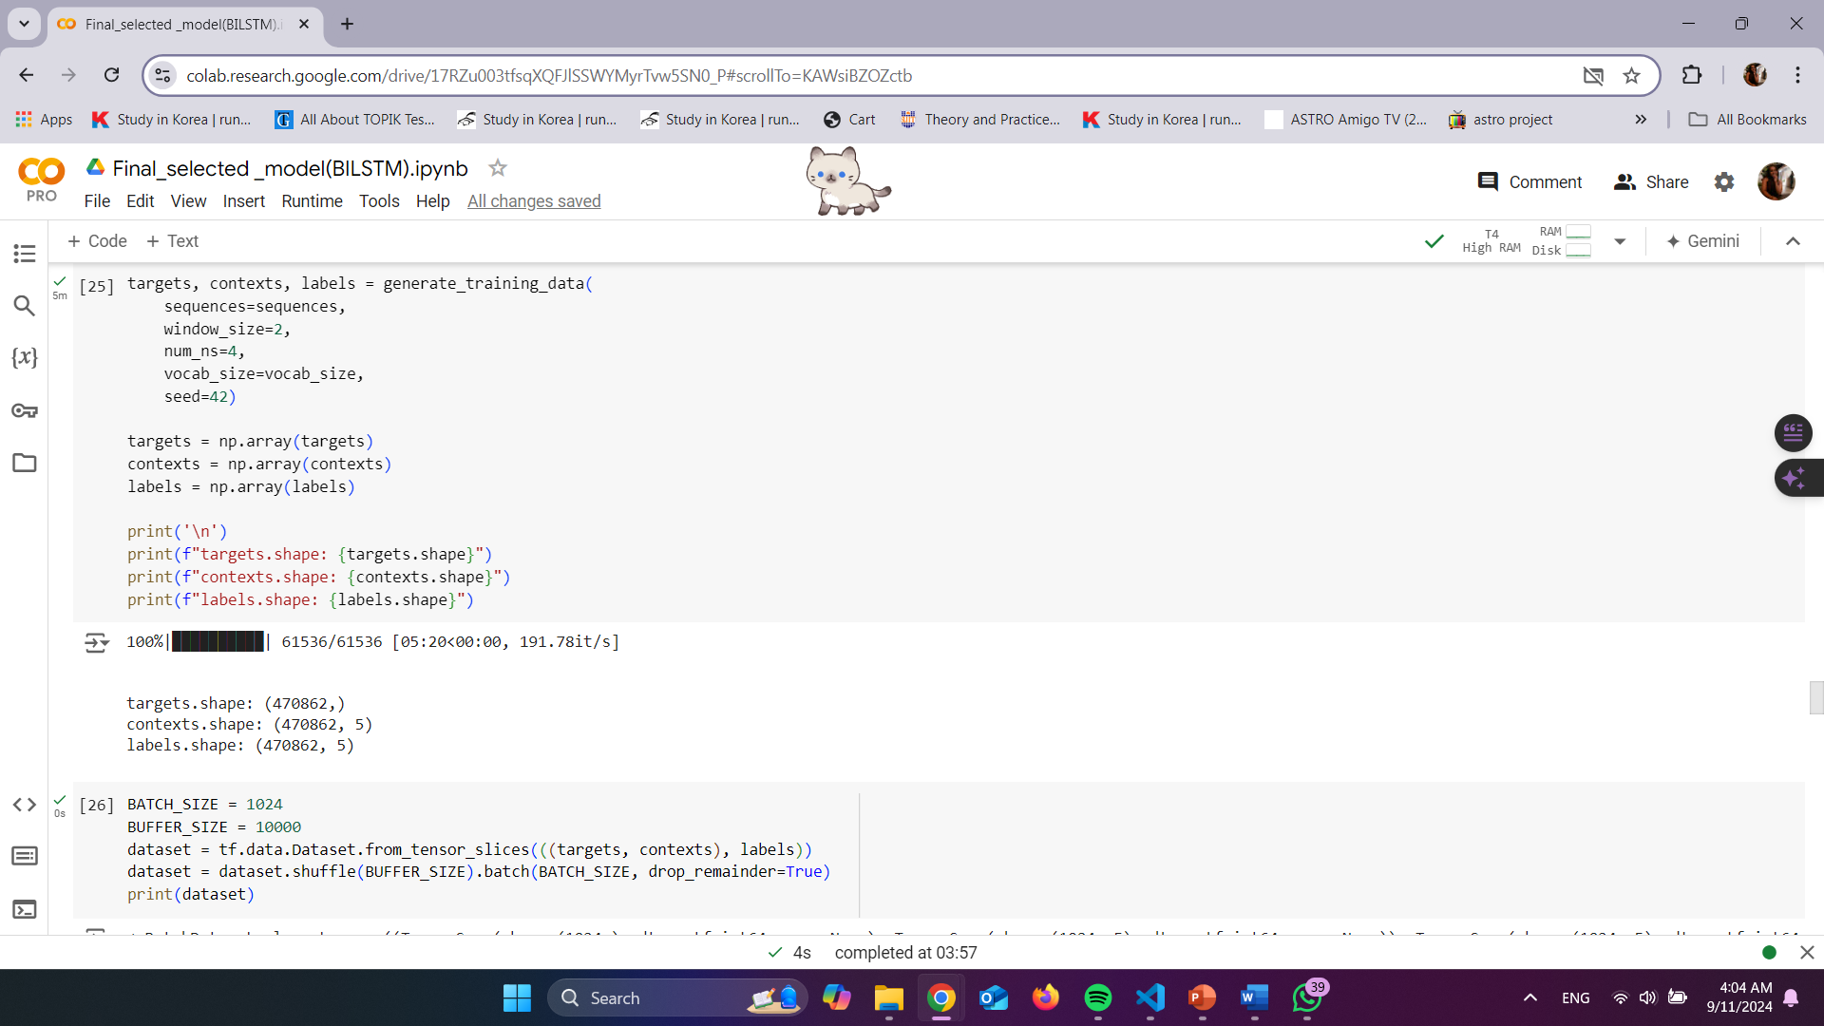
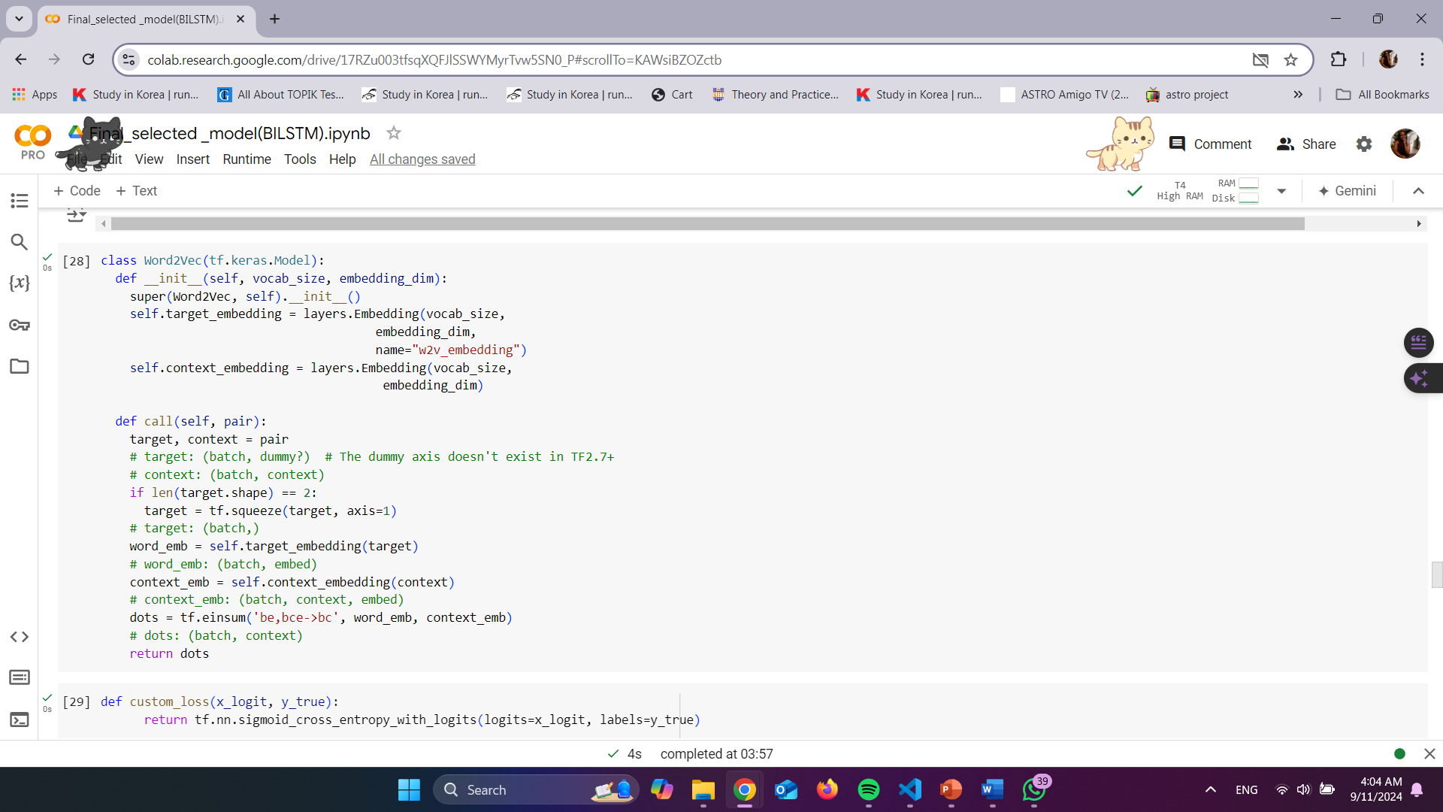
CUSTOMIZED WORD2VEC MODEL
Proof Of Concept
(According to the selected model )
Overview

Slide 18
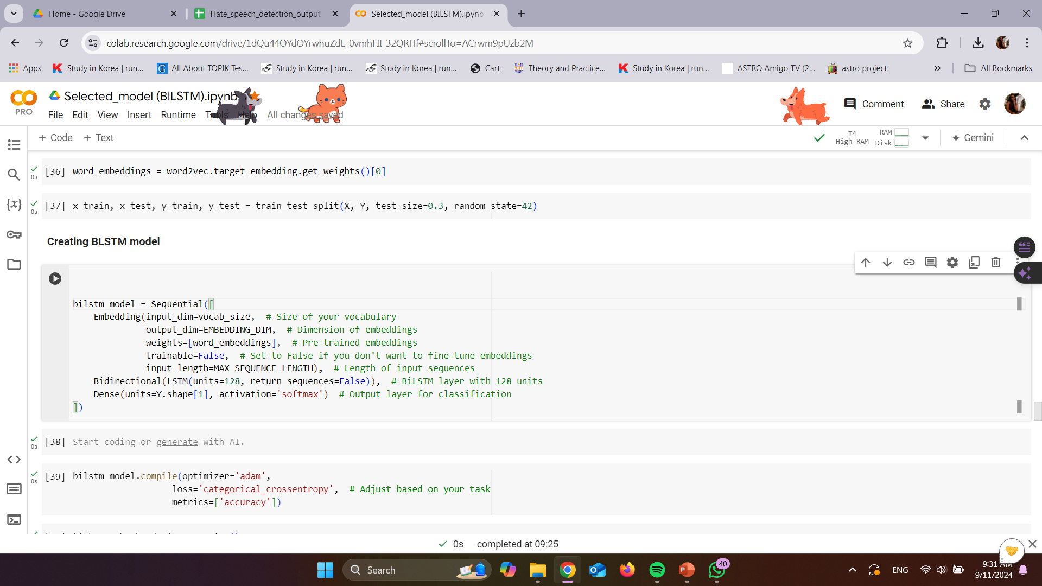
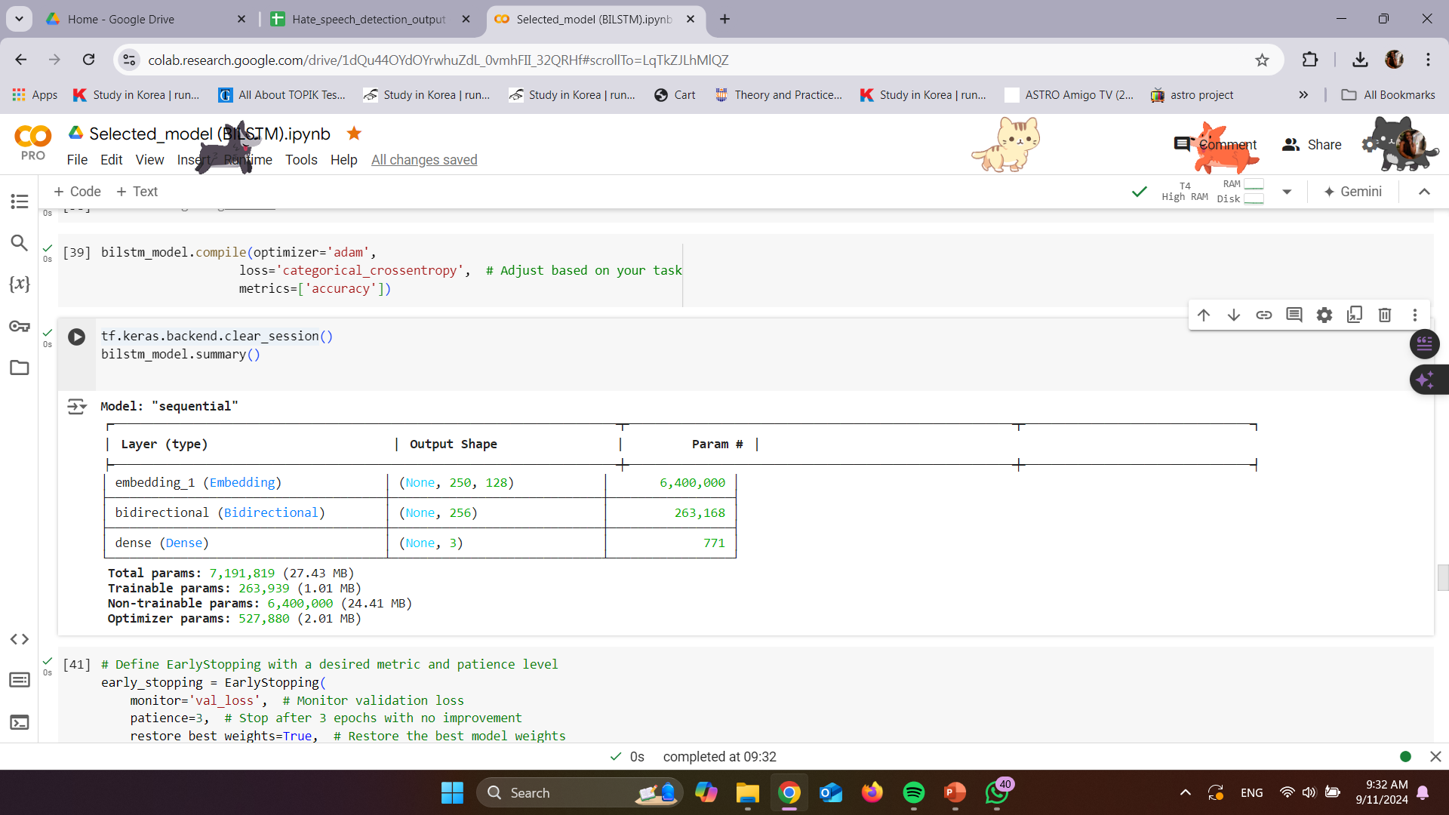
selected model
Proof Of Concept
(According to the selected model )
Overview

Slide 19
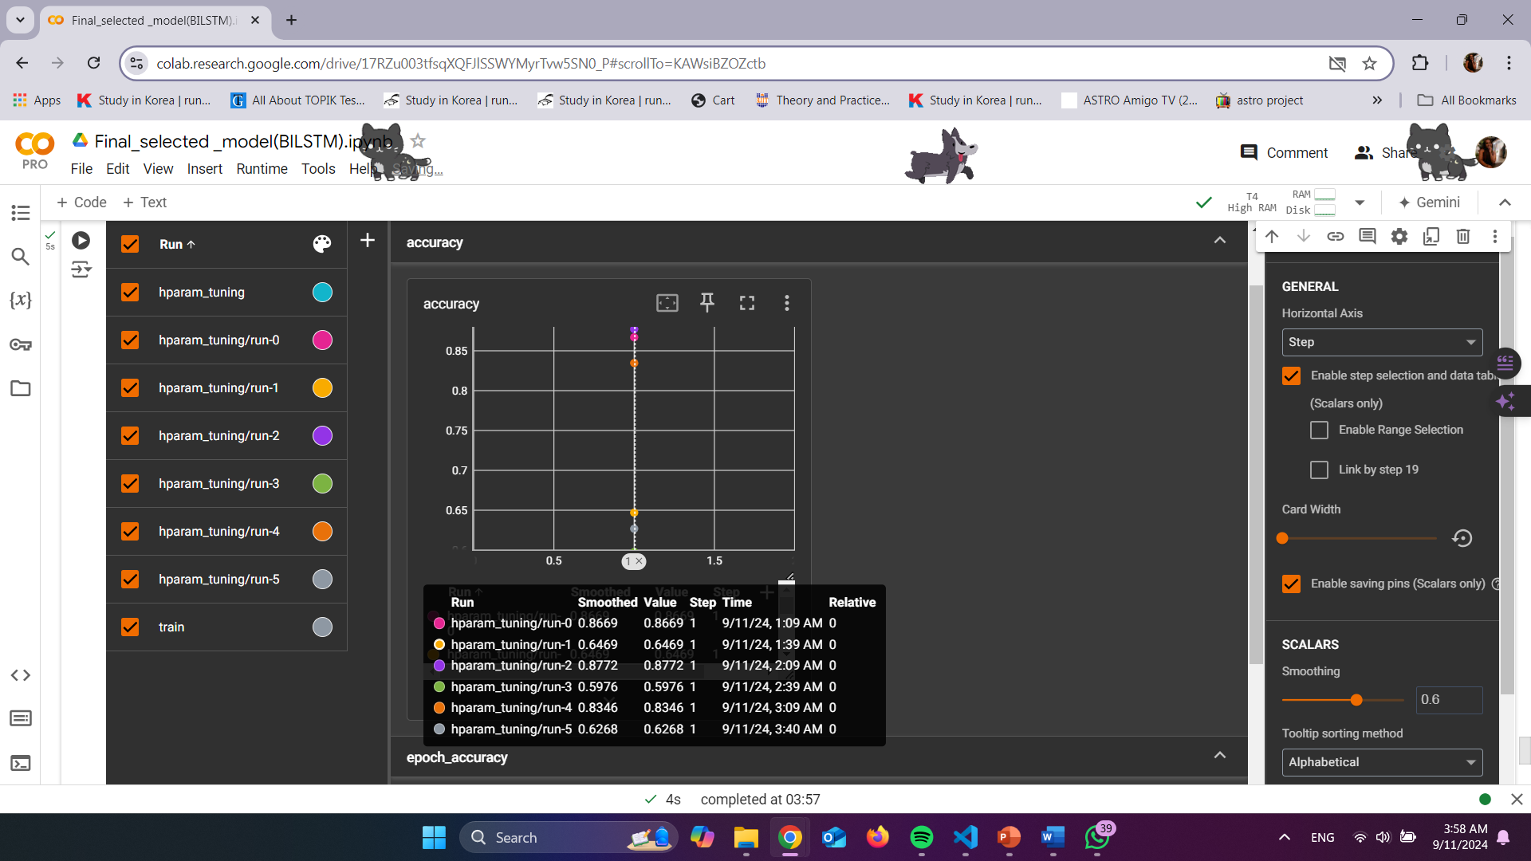
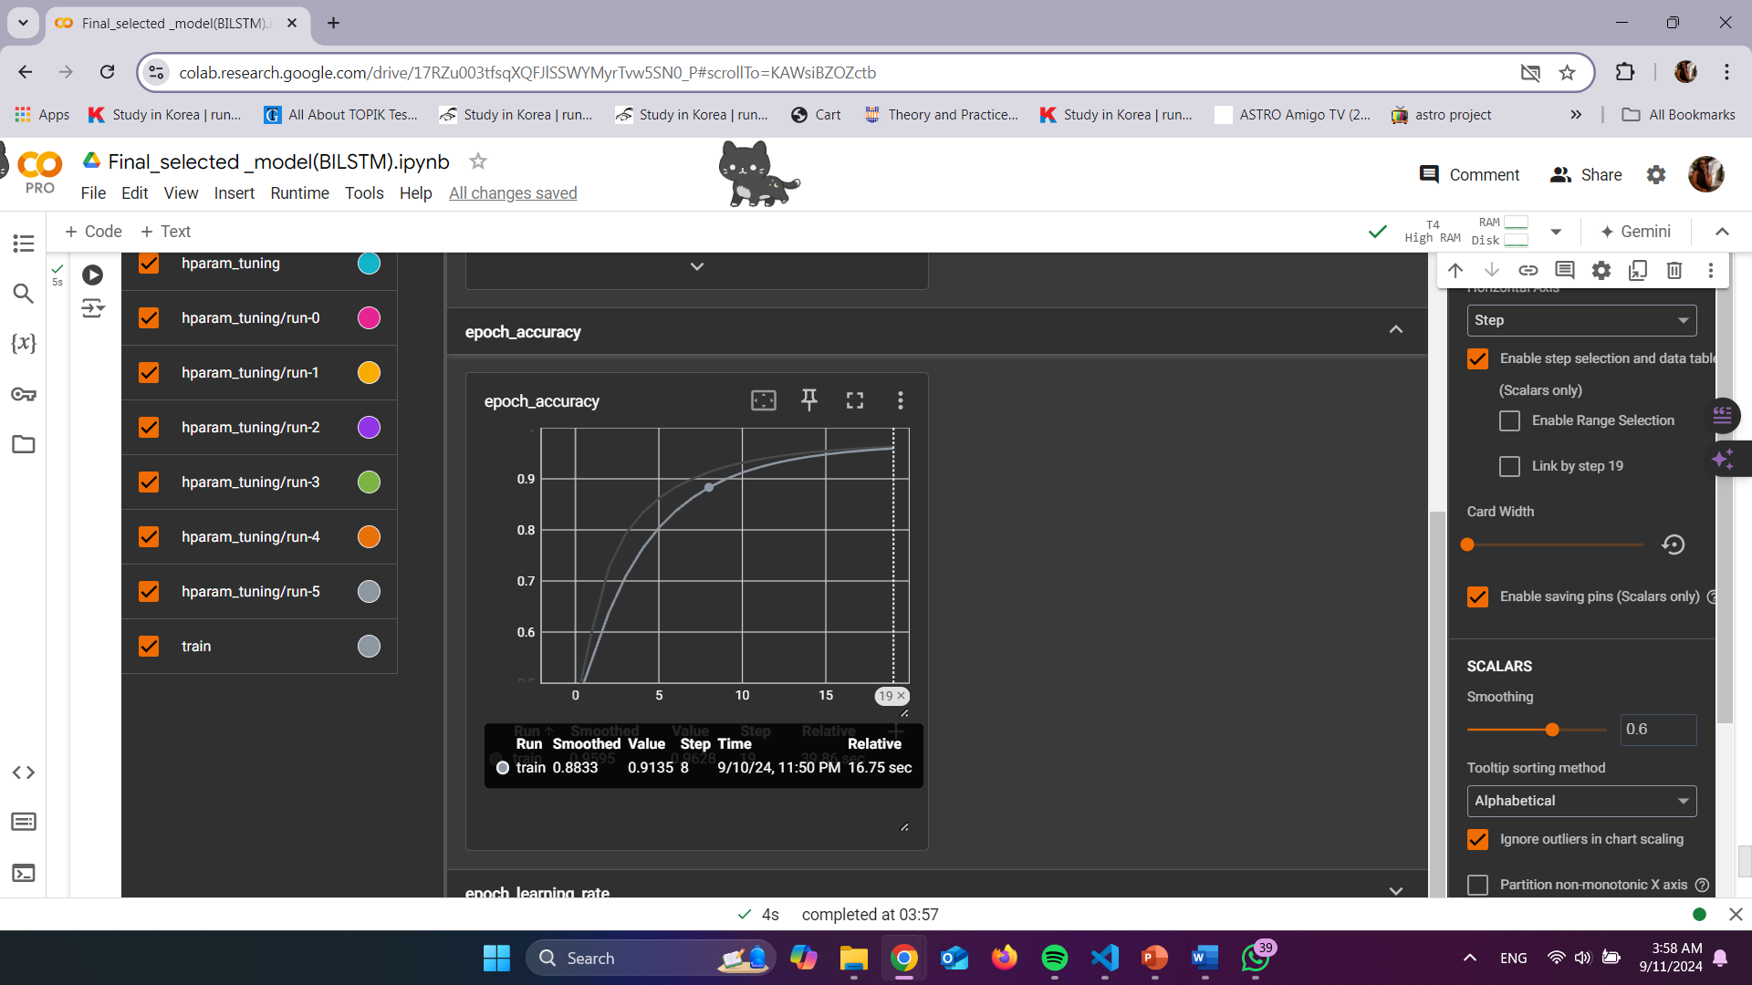
EVALUATION
Proof Of Concept
(According to the selected model )
Overview

Slide 20
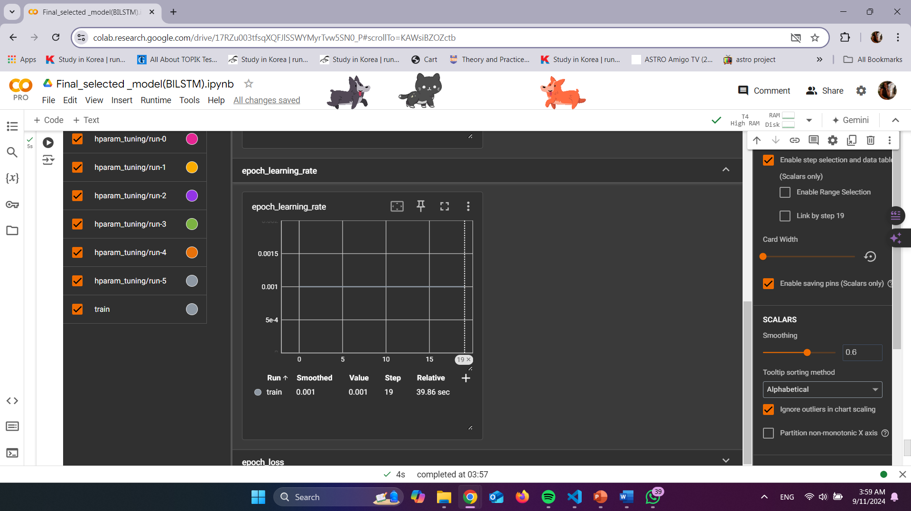
EVALUATION
Proof Of Concept
(According to the selected model )
Overview

Slide 21
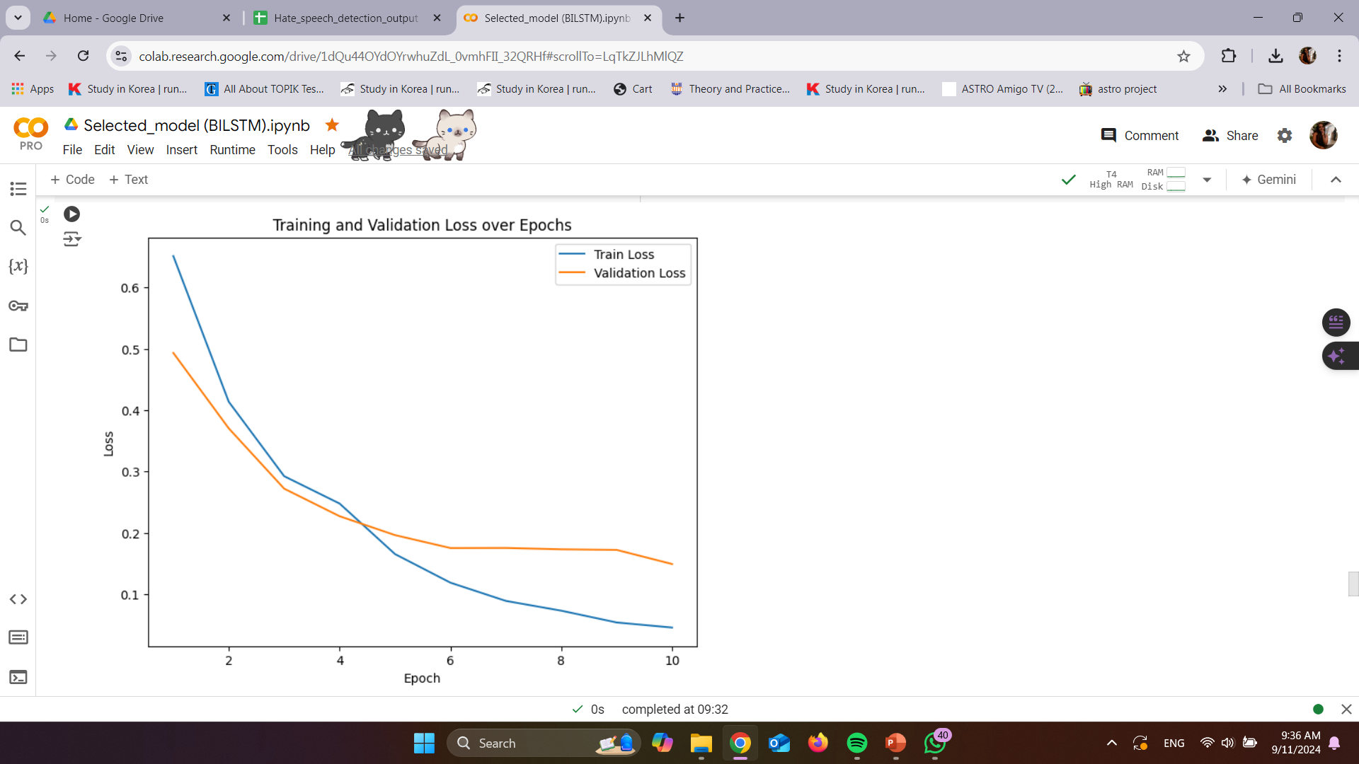
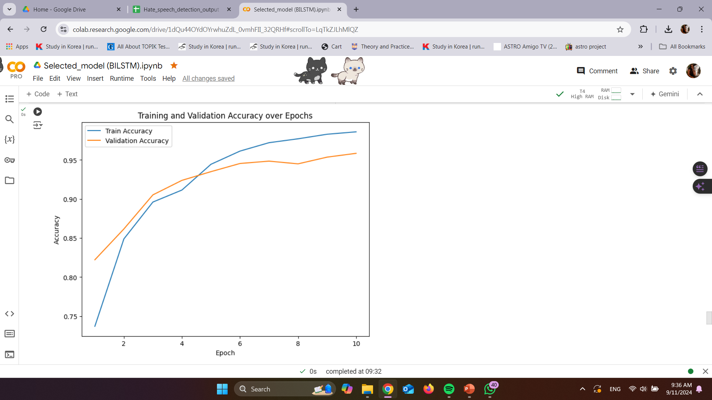
EVALUATION
Proof Of Concept
(According to the selected model )
Overview

Slide 22
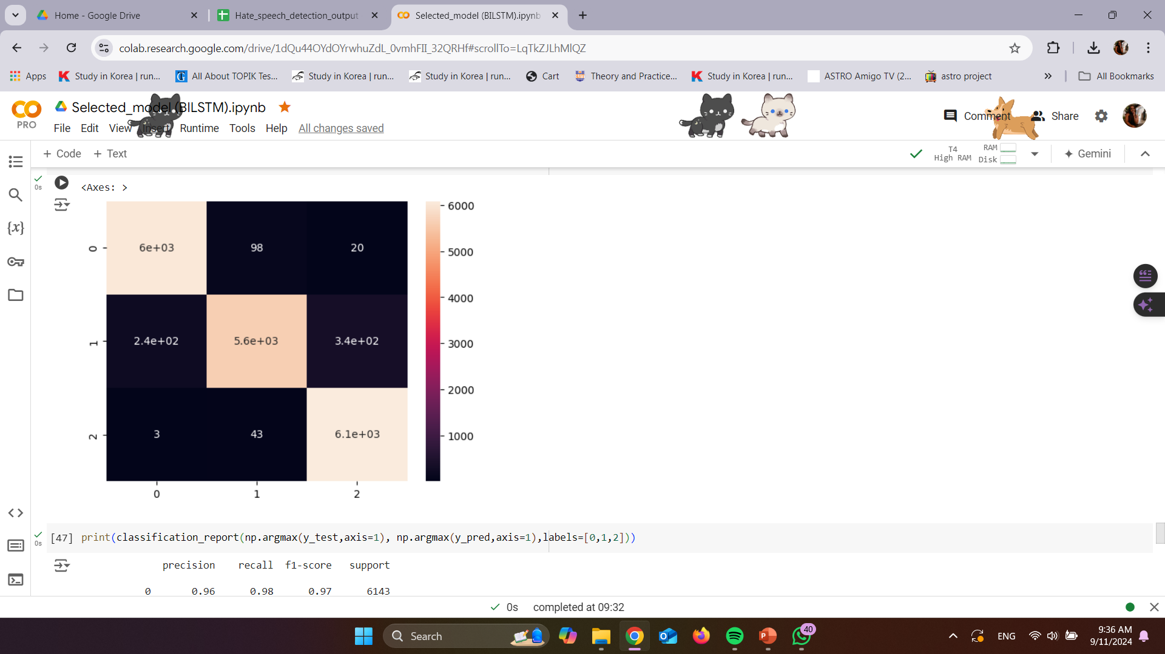
EVALUATION
Proof Of Concept
(According to the selected model )
Overview

Slide 23
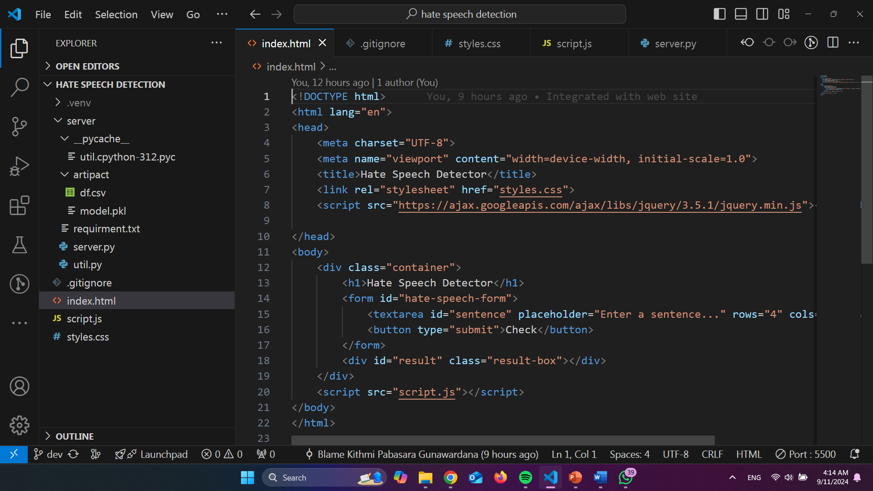
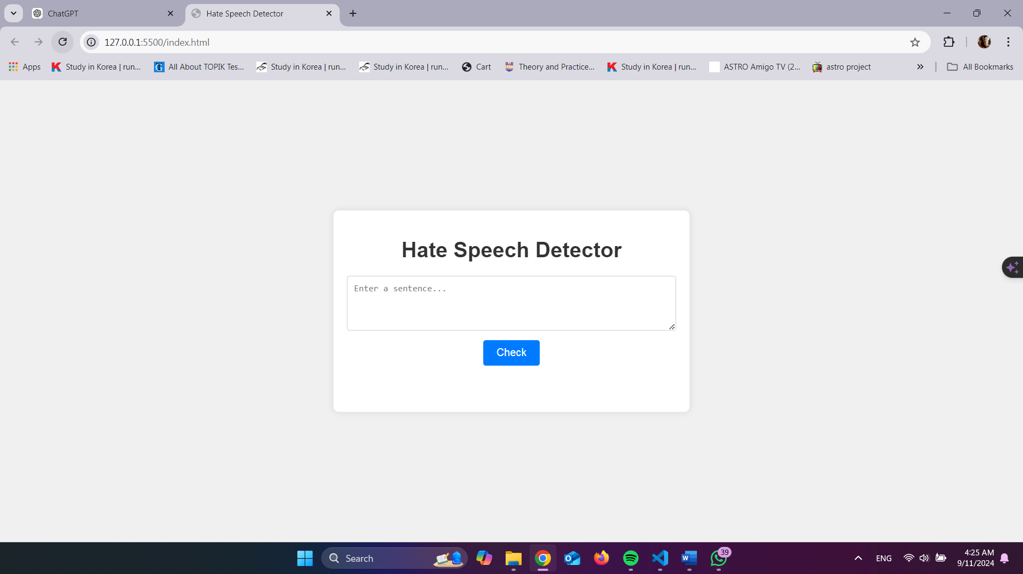
WEBSITE IMPLEMENTATION
Proof Of Concept
(According to the selected model )
Overview

Slide 24
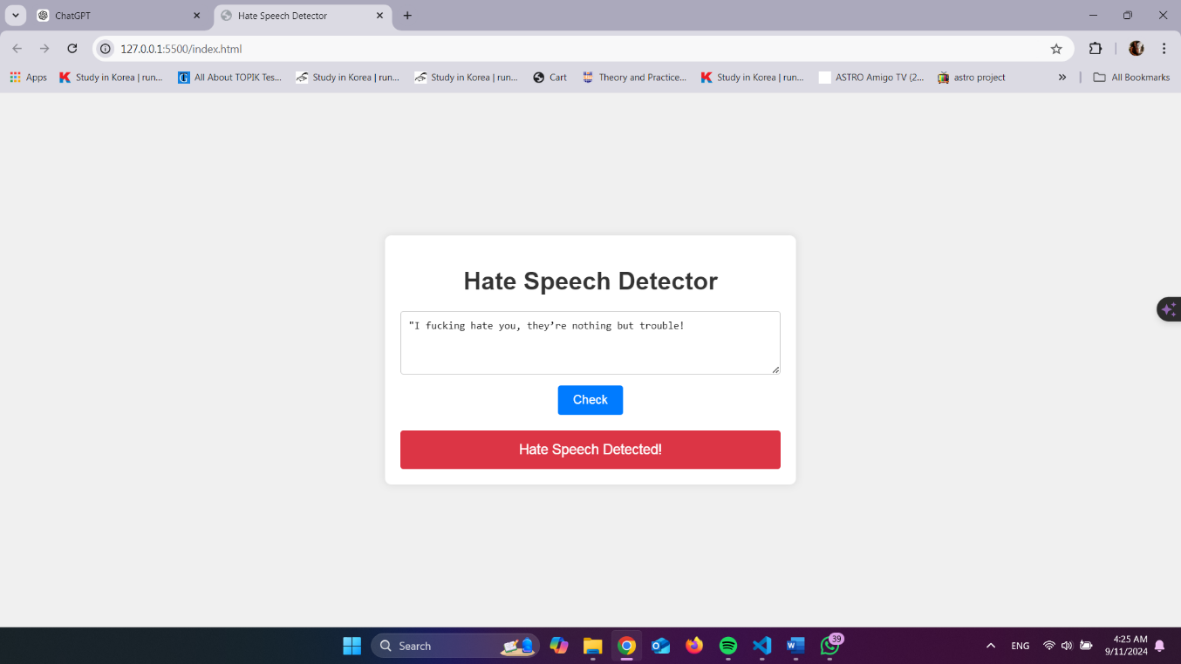
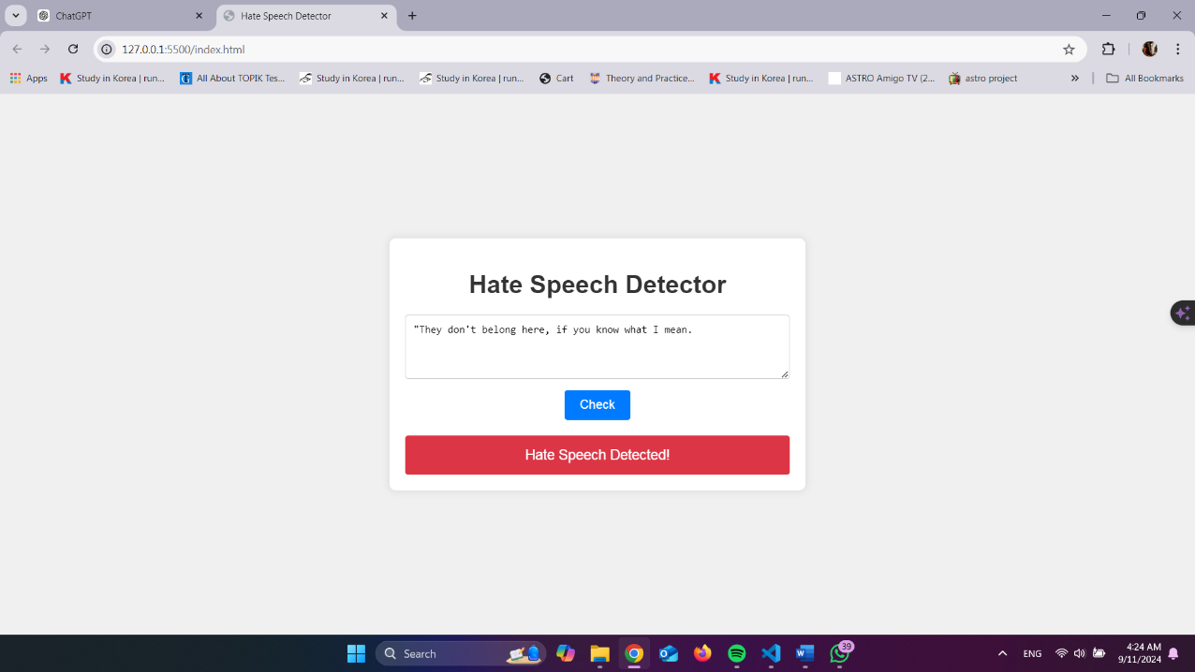
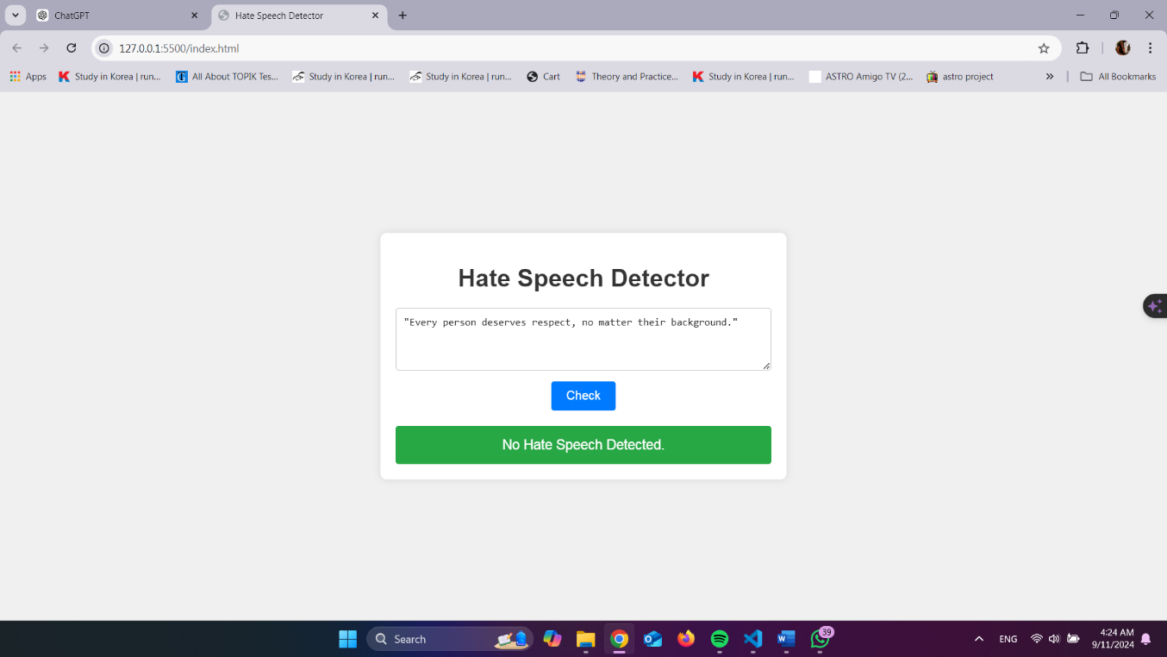
WEBSITE IMPLEMENTATION
Proof Of Concept
(According to the selected model )
Overview

Slide 25
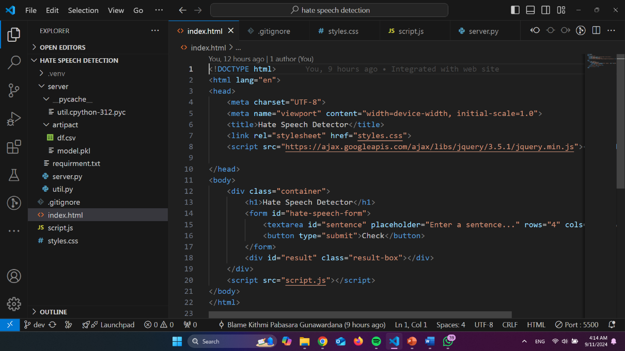
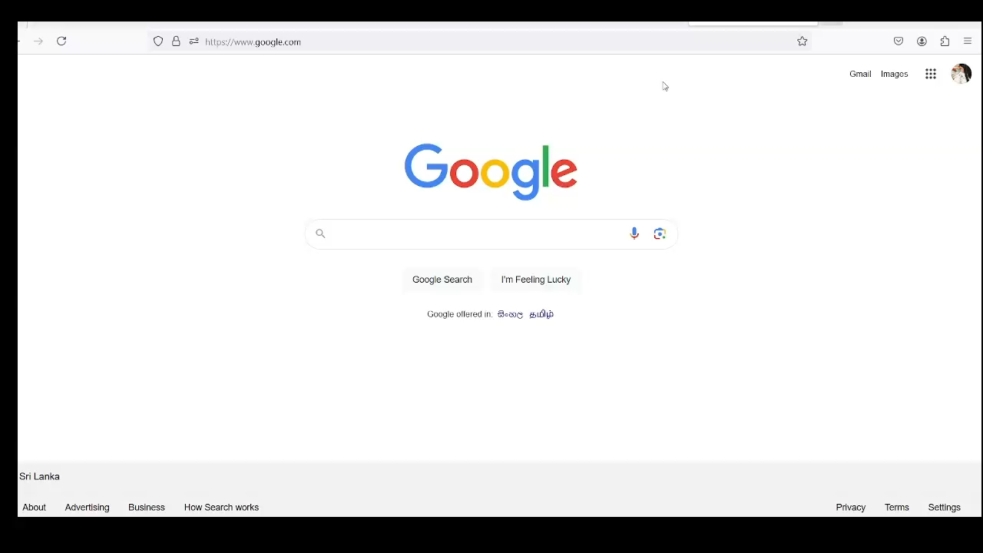

Integration and complete the work
Proof Of Concept
(According to the selected model )
Overview

Slide 26
DEMO AND GITHUB LINK
Proof Of Concept
(According to the selected model )
"No one wants to listen to your bullshit, you annoying prick.“
"Get the fuck out of here; you don’t belong with normal people.“
"People like you are a burden to society, you'd be better off dead.
"Women are only good for cooking and cleaning, nothing more.“
"Being gay is a sickness, and you should be ashamed of yourself.“
"Stop acting like a dumbass, you’re never going to amount to anything.“
"I love how you always find a way to brighten someone’s day
You bring so much joy and positivity wherever you go, and it’s truly uplifting.
"You make the world a better place just by being in it."
Overview

Slide 27
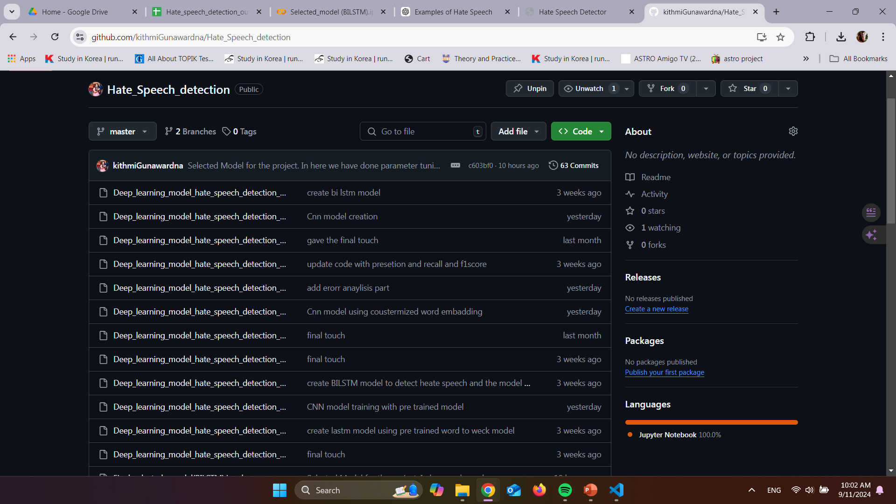
DEMO AND GITHUB LINK
Proof Of Concept
(According to the selected model )
https://github.com/kithmiGunawardna/Hate_Speech_detection
Overview

Slide 28
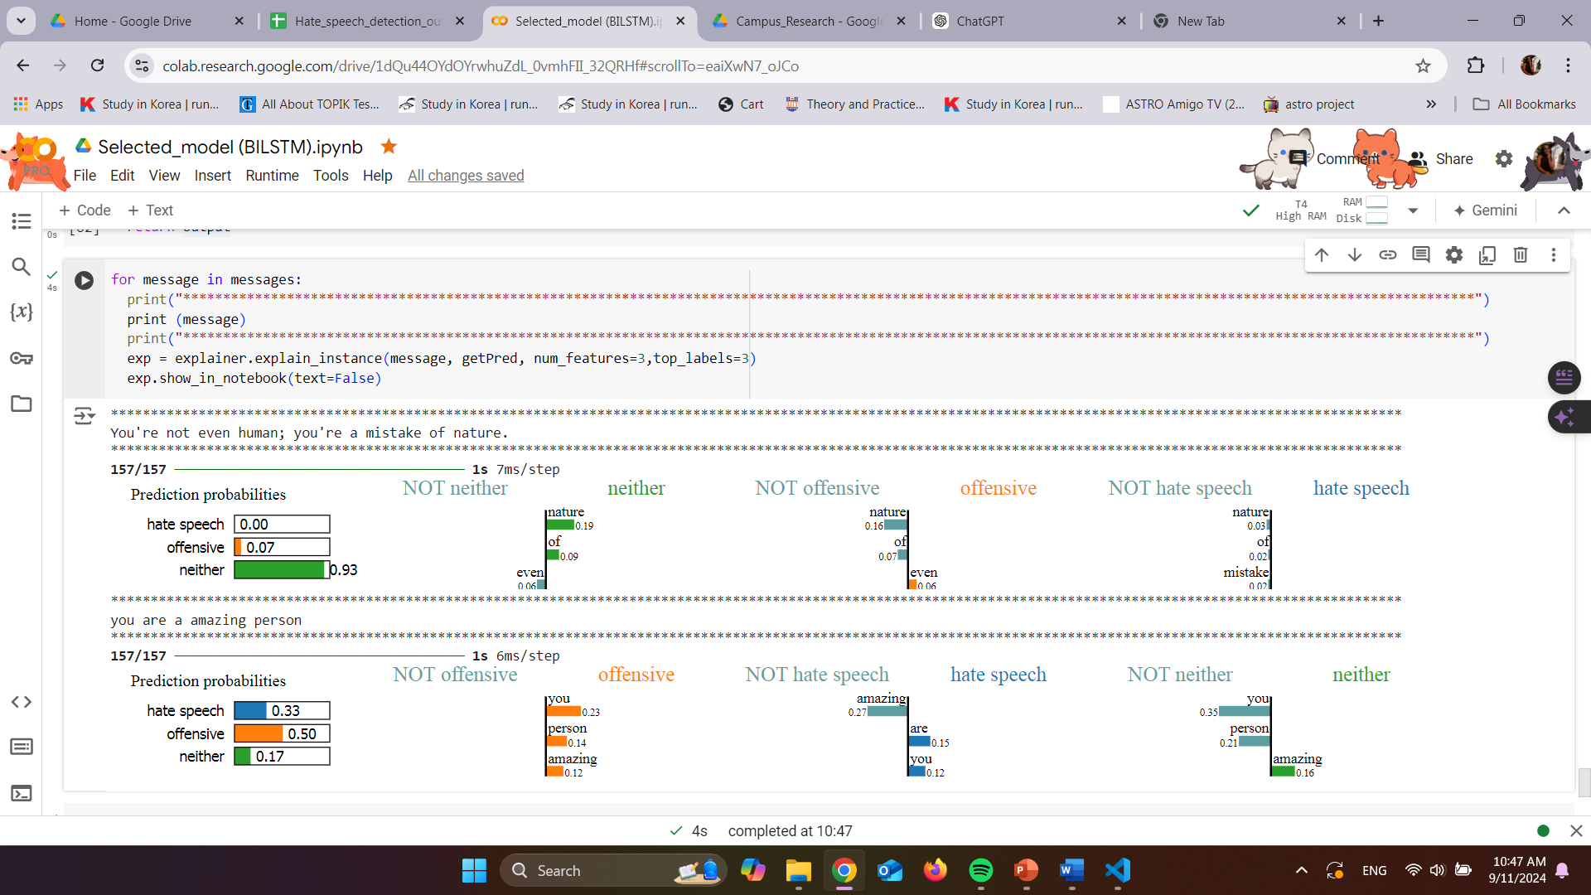
ERROR ANALYSIS
Proof Of Concept
(According to the selected model )
Overview

Slide 29

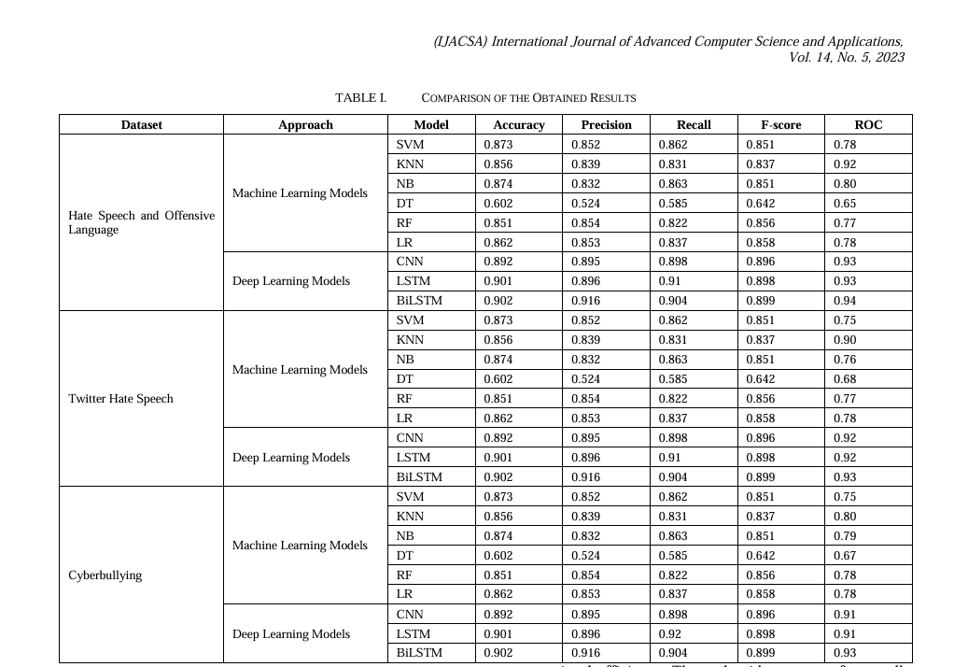
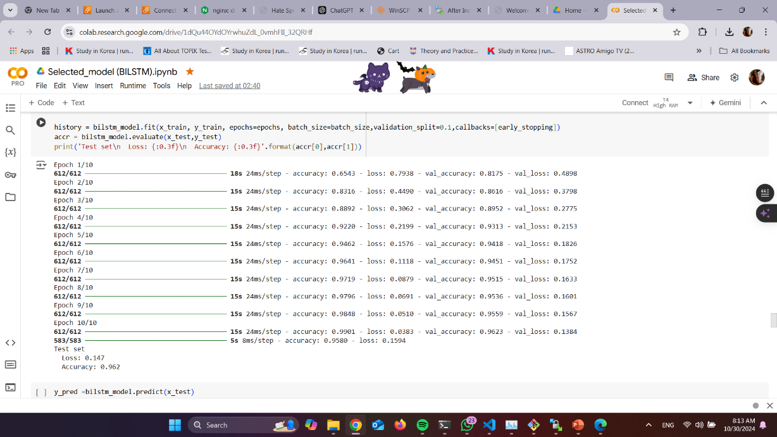

Completed
100 % complete
Gunawardna K.P IT20298876
Data Science | 2024

Slide 30
Sri Lanka Institute of Information Technology
Thank You
Gunawardana K.P
IT2029887
For Your Attention
Data Science | 2024

